Slide 1
TASK 4 : Software Quality Management

Slide 2
INTRODUCTION
Quality Management is to assures the quality of the project deliverables and the quality of the processes and procedures used to manage and develop the deliverables.
The Quality Objectives for Quality Management in the Automated Student Attendance using Fingerprint Approach project are to assure that:
Project deliverables meet their stated requirements.
Product able to meet their quality goals.

Slide 3
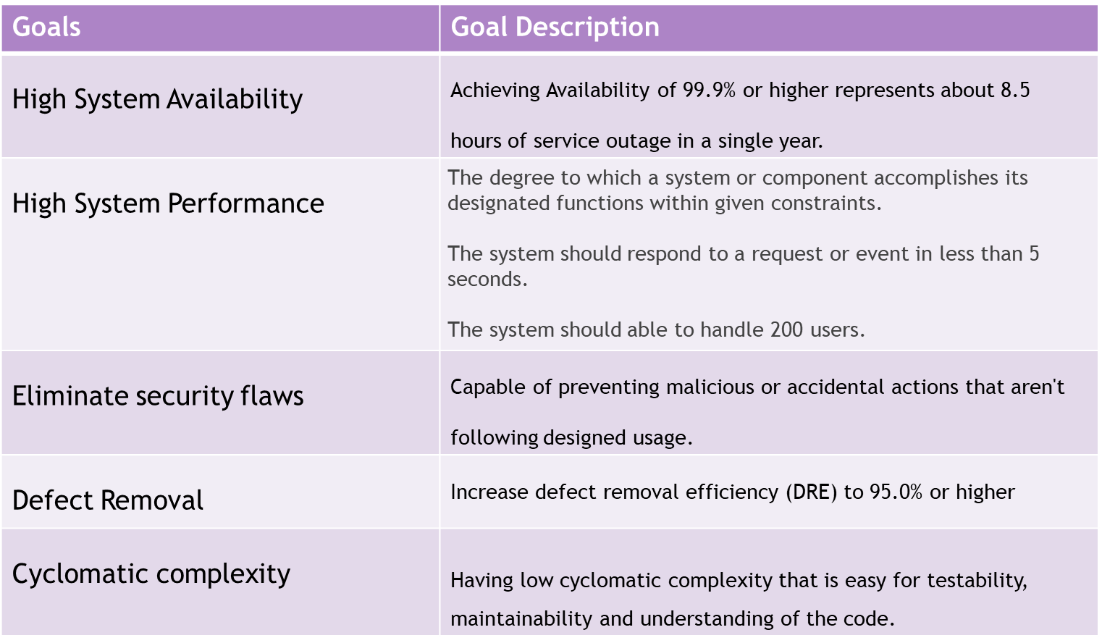
Quality Goal

Slide 4
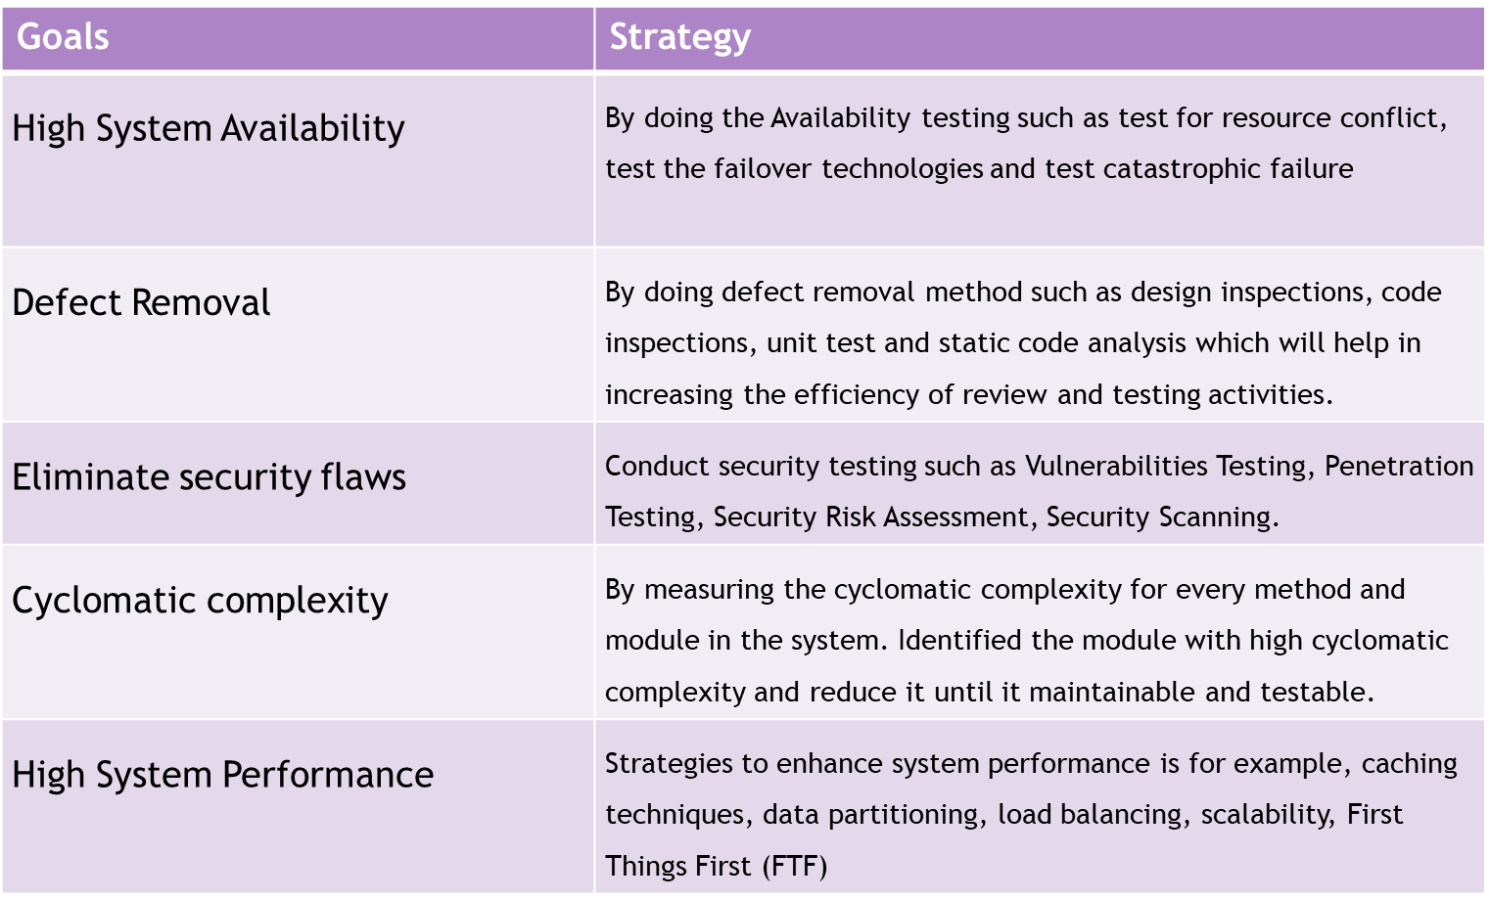
Strategy to achieve

Slide 5

Tools - QACoverage
QACoverage is a new generation test management solution with innovative vision and workflow to manage Software Test Life Cycles more effectively and efficiently.
It boosts test productivity and provides visibility to better handle and control your established QA process via comprehensive Requirements Management, Test Design, Test Execution, Defects Management, and Metrics & Reporting modules.

